Slide 1

NATIONAL PROGRAMME FOR PREVENTION AND CONTROL OF NON COMMUNICABLE DISEASES

Slide 2


Slide 3
OUTLINE-
Introduction
NCD – An Overview
Burden of NCD’s
Evolution of NPNCD
Objectives of NPNCD
Strategies for NPNCD
Organisational structure of NPNCD
Monitoring and Evaluation
Linkage with other Programmes

Slide 4
INTRODUCTION
Non Communicable Diseases (NCDs) are chronic diseases that are not transmissible from one person to another.
It includes wide spectrum of medical disorders both acute and chronic like Cancers, Diabetes, Hypertension, Cardiovascular Diseases and Stroke, Chronic Kidney Diseases (CKDs), Chronic Obstructive Pulmonary Diseases (COPDs) and Asthma, Non-Alcoholic Fatty Liver Disease

Slide 5
CHARACTERISTICS OF NCD’s
Associated with specific risk factors.
Cause permanent damage.
Disability known to occur.
Need Rehabilitation
Require special training of patient for rehabilitation.
Dependency is definate stage in natural history.

Slide 6
RISK FACTORS
Most NCDs are strongly associated with major risk factors such as:
1. Tobacco use (smoking and smokeless)
2. Alcohol use
3. Unhealthy diets
4. Insufficient physical activity
5. Air pollution (indoor and outdoor)

Slide 7

If these risk factors are not managed/modified, they may lead to the following biological risk factors:
1. Overweight/obesity
2. Raised blood pressure
3. Raised blood sugar
4. Raised total cholesterol/lipids

Slide 8
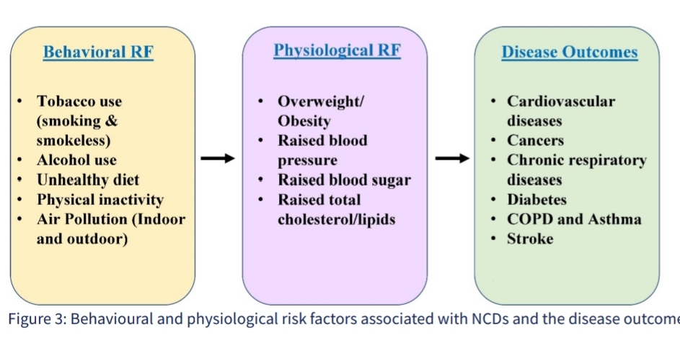

Slide 9
Burden of Non Communicable Diseases
The global NCD burden remains unacceptably high. NCDs are responsible for 41 million of the world’s annual deaths. 17 million of these deaths were premature.
As per the WHO – NCD India profile - 2018, NCDs are estimated to account for 63% of all deaths in country of which the cardiovascular diseases lead with 27% overall mortality cause followed by chronic respiratory diseases (11%), cancers (9%), diabetes (3%) and others (13%)

Slide 10
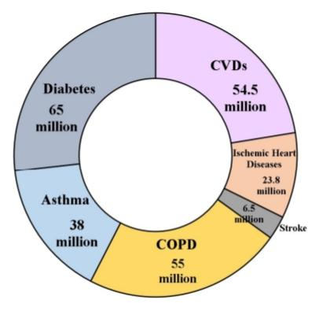
• As per India State-Level Disease Burden Initiative CVD Collaborators - 2016, there were 54.5 million cases of cardiovascular diseases, 23.8 million cases of ischemic heart diseases, 6.5 million cases of stroke, 55 million cases of COPD, 38 million cases of asthma and 65 million cases of diabetes.
In 2016, cardiovascular diseases were responsible for 28.1 percent deaths, while chronic respiratory diseases contributed to 10.9 percent deaths and cancers contributed to 8.3 percent deaths.
Four common NCDs (Cardiovascular Diseases, Cancers, Chronic Respiratory Diseases and Diabetes) account for 23 percent of the total premature mortality in 30-70 years age group.

Slide 11
•Considering the rising burden of NCDs and common risk factors to major Chronic Non- Communicable Diseases, Government of India initiated an Integrated National Programme for Prevention and Control of NCDs.
•The National Health Policy, which was published in 2017, recognized the need to halt and reverse the growing incidence of chronic diseases

Slide 12
•Also, it would be incorporated into comprehensive primary healthcare with linkages to specialist consultation and follow-up at the primary level.
•The NP-NCD Programme has been expanded to cover the entire country. The integration of services at district level and below has been brought under the umbrella of National Health Mission.

Slide 13
Evolution of National Programme for Prevention and Control of Non Communicable Diseases:
Government of India launched NP-NCD formerly NPCDCS in 100 districts of 21 states to combat NCDs in 2010 as per the 11th Five Year Plan. The aim was to provide technical, financial and logistics support to the State Governments.
The programme focuses on health promotion, screening, early diagnosis and management of individuals with NCDs along with addressing their risk factors.

Slide 14
In 2013-2014, the programme was subsumed under the National Health Mission (NHM) for optimization of resources and provide seamless services to the patients, and for ensuring long term sustainability of the programme interventions.
•The Population-Based Screening (PBS) of common NCDs as a part of Comprehensive Primary health Care (CPHC) was initiated in 2016, in selected districts across States/Uts.

Slide 15
From 2016 onwards, the National Multisectoral Action Plan (NMAP) is introduced to offer roadmap and policy options to guide multisectoral efforts involving other Ministries/Department.
There are several other disease interventions such as COPD and Asthma, CKD, Stroke, Non-Alcoholic Fatty Liver Disease (NAFLD) and STEMI, which were included in phased manner under the programme. Further, the name of the programme is changed from NPCDCS to National Programme for Prevention and Control of Non Communicable Diseases (NP-NCD).

Slide 16
Objectives of National Programme for Prevention and Control of NCDs:
Health promotion through behavior change.
Screening, early diagnosis, management, referral and follow-up at each level of healthcare delivery.
Build capacity of health care providers at various levels

Slide 17
Strengthen supply chain management.
Monitoring, supervision and evaluation of programme.
To coordinate and collaborate with other programmes, departments/ministries, civil societies.

Slide 18
Strategies of NP-NCD:
• Health promotion for prevention of NCDs and reduction of risk factors.
• Screening, early diagnosis, management, referral and follow up of common NCDs.
• Capacity building of health care providers.
• Evidence based standard treatment protocols.

Slide 19
• Uninterrupted drug and logistics supply.
• Task sharing and people-centered care.
• Information system for data entry, longitudinal patient records.
• Monitoring, supervision, evaluation and surveillance including technology enabled interventions.

Slide 20
• Multi-sectoral coordination and linkages with other National Programmes.
• Implementation research and generation of evidences.

Slide 21
ORGANIZATIONAL STRUCTURE OF NP-NCD
NCD Division: For effective management of the programme, the NCD divisions have been established at National, State and District headquarters to ensure planning, implementation, monitoring and evaluation of the programme activities.
1)National NCD Division:-
-Plan, implement, coordinate, monitor and support all the activities at the National and State level.
-Develop Technical and Operational Guidelines, Standard Operating Procedures (SOP), Treatment Protocols, Training modules, Quality benchmarks, Monitoring and reporting systems and tools, IEC materials.

Slide 22
2)State NCD Division:-
-Preparation of State action plan including physical and financial targets for implementation of NP-NCD.
-Maintain district-wise epidemiological profile for identified NCDs.
-Ensure regular supply of drugs, diagnostics and logisticsresource
-Organize state and district level trainings for capacity building of all cadres of human resources.
3)District NCD Division:
-It is responsible for overall planning, implementation, monitoring and evaluation of the different activities and achievement of physical and financial targets planned under the programme in the district.

Slide 23
Activities and interventions at various levels:
•AT COMMUNITY LEVEL-
-Active enumeration of the eligible population and registration of the families, risk assessment of NCDs using Community Based Assessment Checklist (CBAC)
-Mobilization of community for screening of NCDs.
-Health promotion, lifestyle modification, follow up for treatment compliance and lifestyle modification.

Slide 24
•AT SUBCENTRE LEVEL
-Health education for awareness generation and behaviour change, organising wellness activities.
-Screening of Diabetes, Hypertension, three common cancers (oral, breast and cervical).
-Referral of suspected cases to PHC/PHC-HWC or nearby health facility for diagnosis confirmation and management.
-Dispensing of prescribed medicines and follow up of patient for treatment compliance and lifestyle modification.
-Maintaining Electronic Health Records (EHR) and generation of ABHA IDs.

Slide 25
•AT PHC LEVEL-
-Health promotion activities including wellness activities for behaviour change.
-Screening of Diabetes, Hypertension, three common cancers (oral, breast and cervical), COPD and Asthma, CKD, NAFLD among OPD attendees.
-Confirmation of diagnosis, treatment initiation, and management of common NCDs as per standard management protocol and guidelines.
-Referral of complicated NCD cases to higher facilities.
-Teleconsultation services and counselling services.
-Maintaining Electronic Health Records

Slide 26
•AT CHC LEVEL-
-Health promotion including counselling.
-Opportunistic screening of Diabetes, Hypertension, three common cancers (oral, breast and cervical)..Screening of COPD and Asthma, CKD, NAFLD, STEMI among suspected cases.
-Confirmation of diagnosis, treatment initiation, and management of common NCDs as per standard management protocol and guidelines.
-Teleconsultation services and counselling services and maintaining Electronic Health Records
-Management of cases of common NCDs and regular follow-up and referral of complicated cases to District Hospital/higher healthcare facility.

Slide 27
AT DISTRICT HOSPITAL LEVEL-
• Opportunistic screening of Diabetes, Hypertension, three common cancers (oral, breast and cervical)and screening of COPD and Asthma, CKD, NAFLD, STEMI among suspected cases.
• Diagnosis and management of cases of common NCDs: outpatient and inpatient care, including emergency care particularly for cardiac and stroke cases.
• Management of complicated cases of common NCDs, or referral to higher healthcare facility.
• Follow-up cancer chemotherapy and palliative care services for cancer cases, physiotherapy services for NCDs including Stroke patients, Dialysis facilities for CKD patients, etc.
• Health promotion for behaviour change and counselling for NCD cases.
• Teleconsultation services and counselling services and maintaining Electronic Health Records

Slide 28
AT MEDICAL COLLEGE AND TERTIARY CARE CENTRES-
Diagnosis and management of complicated cases of common NCDs acts as tertiary referral facility.
Comprehensive cancer care.
Support programme in capacity building of health staff.
Support programme in preparing standard guidelines and protocols.
Support in supervision, monitoring, evaluation and operational research.
- Teleconsultation services and counselling services and maintaining Electronic Health Records

Slide 29
Innovative Strategies
Observance of NCD Week/Fortnightly (Swasth Nagrik Saptah/Pakhwara)-Observance of World Stroke Day i.e., 29th October, National Cancer Awareness Day i.e., 7th November and World Diabetes Day i.e., 14th November every year.
m-Health Strategies- m-Diabetes and m-Cessation interventions
K4H- Knowledge for Health for NCDs
Advocacy and Network with People Living with NCDs (PLNCDs)
NCDNet

Slide 30
MONITORING AND EVALUATION
-Programme monitoring and evaluation cycle requires identification of national and sub-national level of indicators that measures inputs, process, outputs, outcomes and impact.
-There are four components of programme monitoring and evaluation cycle:
1. Programme monitoring- Data collection, performance management and data quality assurance
2. Evaluation- Use of data for decision making, rapid assessment of program effectiveness and impact
3. Learning- Documentation, reporting and dissemination of findings/learning
4. Planning- Defining indicators and data source

Slide 31
LINKAGES WITH OTHER PROGRAMMES
Joint TB-diabetes collaborative activities
National Programme for Palliative care (NPPC)
Integration with National Urban Health Mission (NUHM)
National Oral Health Programme (NOHP)
National Tobacco Control Programme (NTCP)
National Programme for Health Care of Elderly (NPHCE)
National Programme for Control of Blindness and Visual Impairment (NPCB&VI)

Slide 32
National Mental Health Programme (NMHP)
Ayushman Bharat - Pradhan Mantri – Ayushman Bharat Health Infrastructure Mission (PM-ABHIM)
Ayushman Bharat - PM-JAY
Rashtriya Bal Swasthya Karyakram (RBSK)
Rashtriya Kishor Swasthya Karyakram (RKSK)
Rastriya Arogya Nidhi (RAN)

Slide 33
THANK YOU

